Slide 1

RISK AND RESILIENCE BOOTCAMP
12

Slide 2


Slide 3

Risk Mapping
This module looks at the process of risk mapping
Identifying specific resources, people and processes where identified risk can occur
Assessment of the real world vulnerabilities that can be exploited by a risk event

Slide 4
Risk Mapping
Process of
Identifying visualizing and prioritizing operational risks across systems, processes, and technologies
Provides structured view of
Vulnerabilities exist within IT operations
How failures or threats in those areas could impact business continuity or service availability
From a resilience perspective, risk mapping helps operations teams:
Understand where key failure points exist
Prioritize controls and monitoring
Align mitigation plans with business-critical assets
Support decision-making for resource allocation and automation
Turns abstract risk discussions into actionable visual and process-based plans

Slide 5
Risk Mapping
Operational environments are complicated
Combinations of on-premises, hybrid, or cloud
Complex ecosystems involving
Infrastructure, software, people, and third-party dependencies
Without a clear risk map, responds tend to be reactive instead of proactive
Role of a risk map
Links technology components (servers, APIs, networks) to business services
Shows dependencies and cascading failure points
Highlights where controls are applied or missing
Enables resilience-by-design through targeted process improvements

Slide 6
Risk Mapping
Building a risk map
Identify operational domains
List all critical systems and services: compute, network, storage, identity, monitoring, etc
List key activities and dependencies
For each system, document operational processes
For example: patching, user access, backup
Assess risks and controls
Identify where failures could occur and the current controls in place
Assign risk ratings
Use a simple risk scoring model to assign risk
Visualize
Use a heat map or matrix to display risk levels across processes and technologies
Looking for potential points of failure or vulnerabilities to threat
Prioritize actions
Direct resources toward the highest residual risks, those least controlled

Slide 7
Risk Mapping
Integration with SOPs and continuous improvement
Risk mapping is not a one-time exercise, it is an ongoing process
Feeds into
Continuous monitoring dashboards
Post-incident reviews and corrective action plans
SOP updates and process reviews
Training for operational teams to raise awareness of risk ownership.
Mature risk and resilience program uses risk mapping to
Continuously align operational practices with business priorities
Detect weak points before failure
Validate recovery capability through testing and measurement

Slide 8
Example
Risk Mapping for IT Operations
Web-based banking application hosted in a hybrid cloud environment.
Operations include patching, access management, backup, monitoring, and incident response
The goal of the risk map is to identify where failures or vulnerabilities may occur and how well existing controls protect against them.
Step 1: Identify key operational domains
Patching OS and application updates
Access Control User and admin account management
Backup Data protection and recovery
Monitoring System and service health checks
Incident Response Issue triage and communication

Slide 9
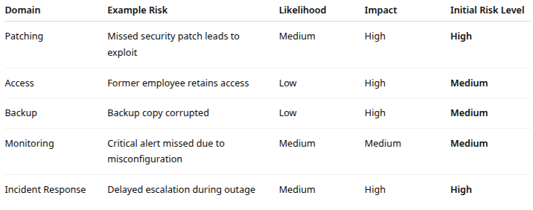
Example
Step 2: Identify risks, likelihood, and impact

Slide 10
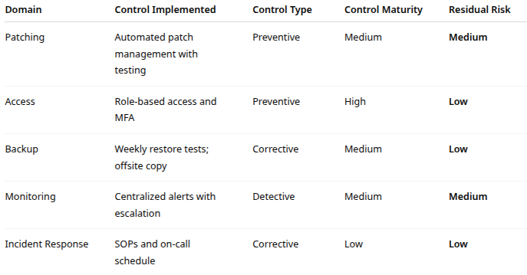
Example
Step 3: Identify controls

Slide 11
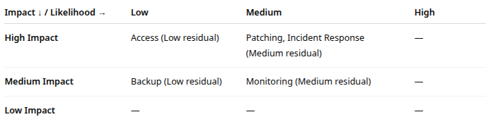
Example
Step 4: Visualize as a risk heat map

Slide 12
Example
Step 5: Interpret the map
High-risk areas
Patching and Incident Response: need process improvement or stronger automation
Low-risk areas
Access and Backup: mature controls already in place
Next step:
Focus improvement on patch management automation and escalation response time

Slide 13
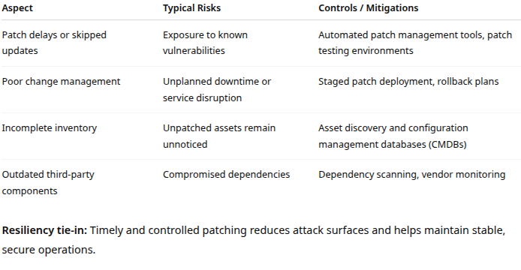
Operational domains to map
Patching and vulnerability management
Maintain system integrity and security by keeping software current

Slide 14
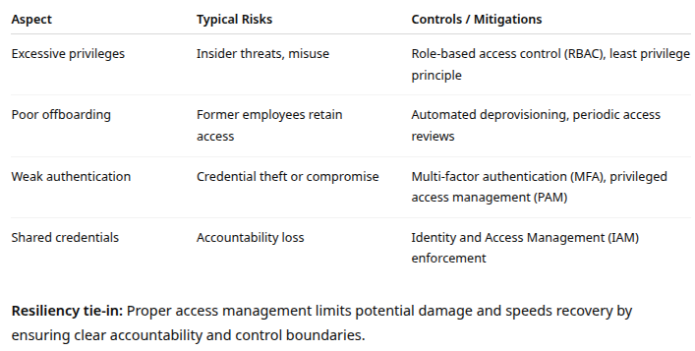
Operational domains to map
Access management
Ensure that only authorized individuals have the right level of access to systems and data

Slide 15
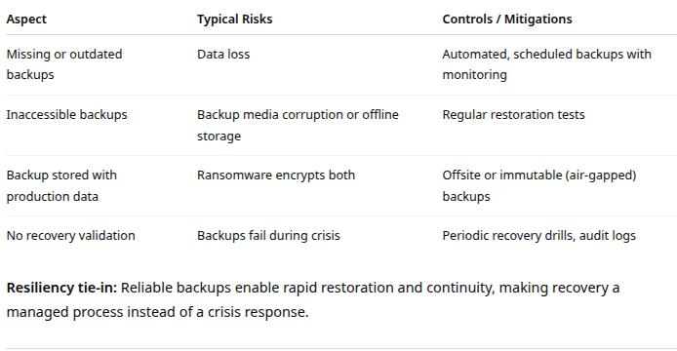
Operational domains to map
Backup and data protection
Preserve data availability and integrity in the event of system failure, corruption, or attack (e.g., ransomware)

Slide 16
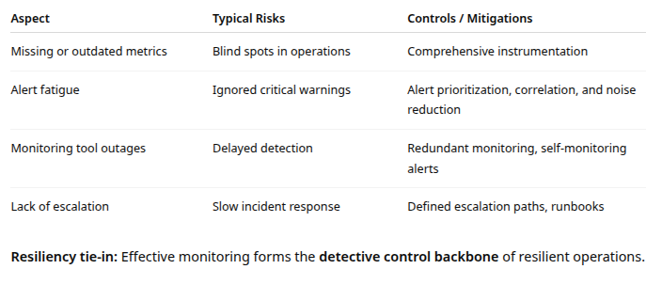
Operational domains to map
Monitoring and alerting
Detect anomalies, performance degradation, and failures early to enable fast response

Slide 17
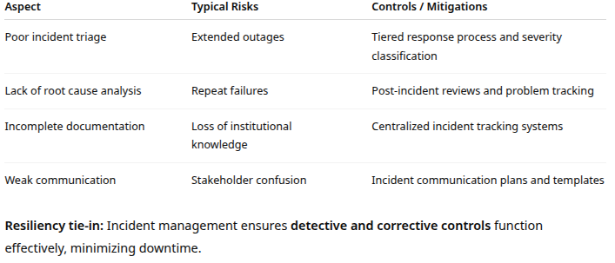
Operational domains to map
Incident and problem management
Detect anomalies, performance degradation, and failures early to enable fast response

Slide 18
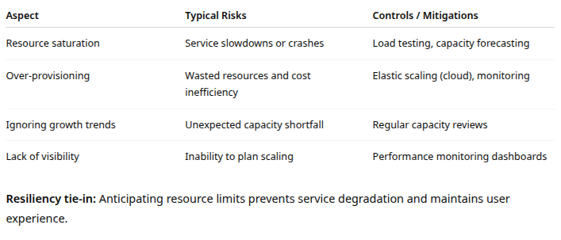
Operational domains to map
Capacity and performance management
Detect anomalies, performance degradation, and failures early to enable fast response

Slide 19
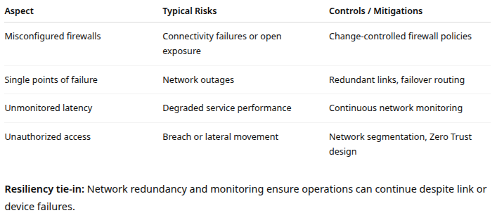
Operational domains to map
Network and connectivity management
Maintain secure and reliable network connectivity between systems and users

Slide 20
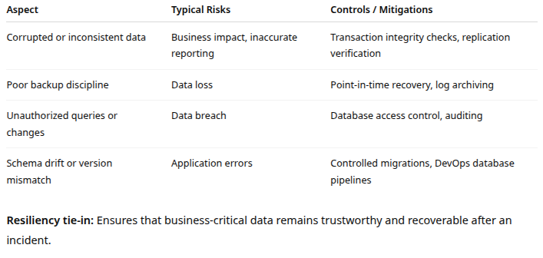
Operational domains to map
Data integrity and database operations
Maintain accuracy, consistency, and recoverability of data across all systems

Slide 21
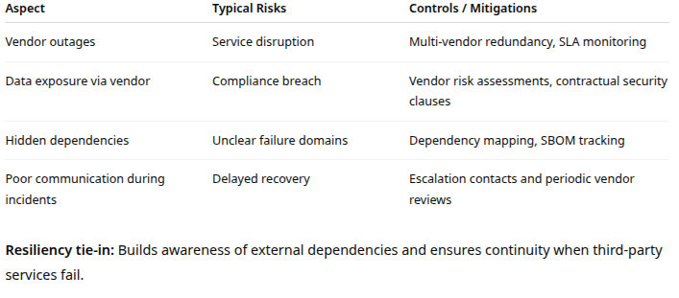
Operational domains to map
Vendor and third-party dependency management
Manage risk from external suppliers, platforms, and service providers

Slide 22
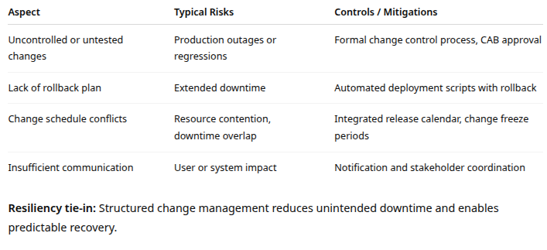
Operational domains to map
Change and release management
Manage updates, deployments, and system configuration changes without disrupting operations

Slide 23
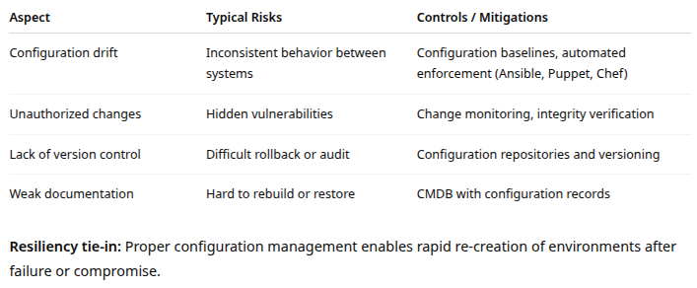
Operational domains to map
Configuration management
Ensure systems and software are consistently and securely configured across environments

Slide 24
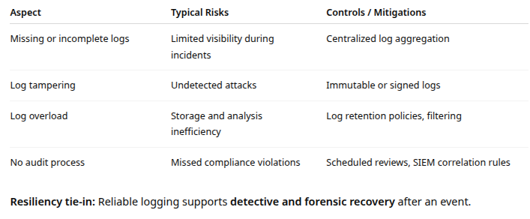
Operational domains to map
Logging and audit management
Maintain detailed, tamper-proof logs for forensics, compliance, and risk analysis

Slide 25
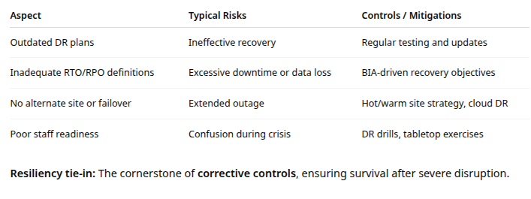
Operational domains to map
Disaster recovery and business continuity
Maintain detailed, tamper-proof logs for forensics, compliance, and risk analysis

Slide 26
Integrated Unified Risk Map
These domains together form a comprehensive operational risk picture
A well-built map will
Link each domain to critical business services
Classify risks as preventive, detective, or corrective
Assign ownership: who monitors, who remediates
Integrate with SOPs and maturity models
Example
Preventive: Patching, Change Control, Access
Detective: Monitoring, Logging, Incident Response
Corrective: Backup/Restore, DR/BCP, Problem Management

Slide 27
Risk Mapping and Process Maturity
In operational risk and resilience management
Risk mapping shows where vulnerabilities and control gaps exist
Process maturity indicates how well those risks are being managed through consistent, repeatable, and measurable processes.
A risk map tells you what can go wrong
Process maturity tells you how ready you are to handle it

Slide 28
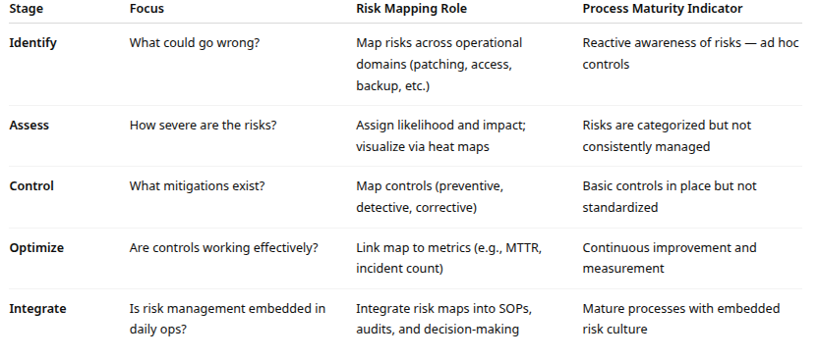
Risk Mapping and Process Maturity

Slide 29
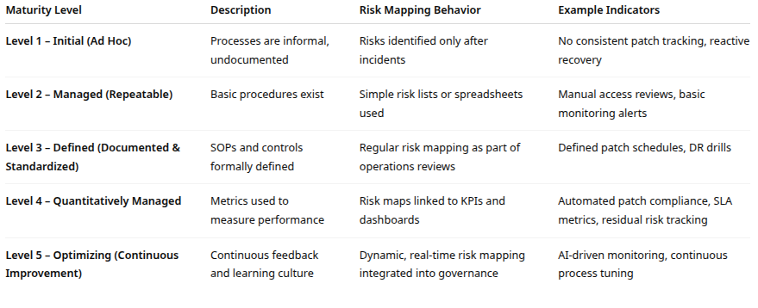
Risk Mapping and Process Maturity

Slide 30
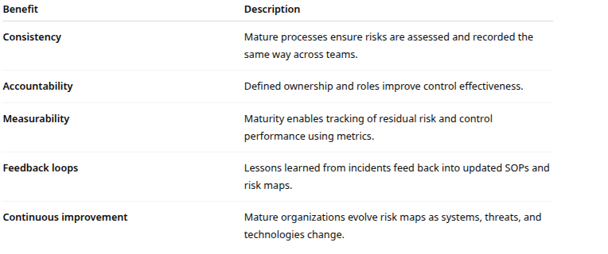
Risk Mapping and Process Maturity

Slide 31

Q&A and open discussion
Notes:
Now is the time to engage in an interactive Q&A session where you can ask questions, share insights, and clarify any doubts about the topics we have covered so far.
This open discussion is designed to ensure that every participant has the opportunity to voice their thoughts and learn from the collective experience of the group.
Your questions and comments are valuable as they help us identify areas that may need further explanation and enable us to tailor future sessions to your needs.
We encourage you to speak up and contribute to the dialogue, as this interaction is one of the key components of our interactive learning approach.
As the session progresses, take note of any questions or ideas that you would like to revisit, and feel free to share your perspectives with the class.

